Slide 1

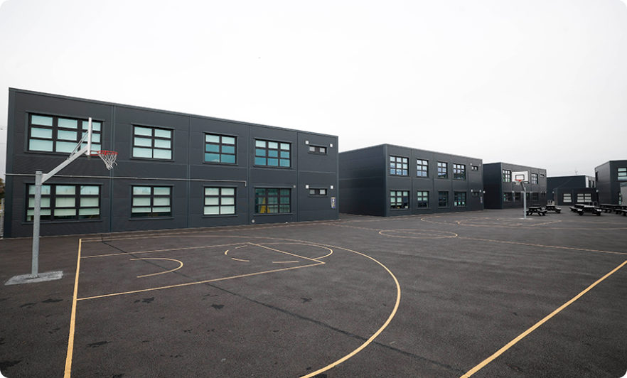
UDL – GOREY ETSS

Slide 2
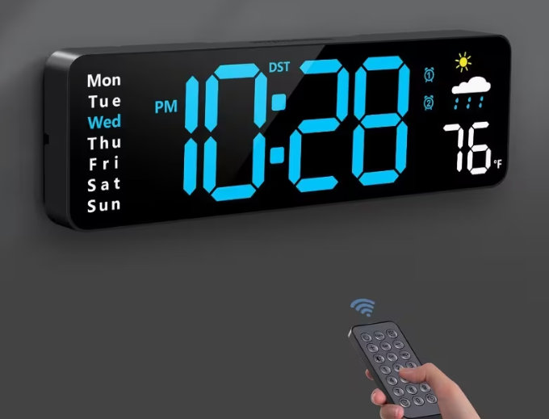
What did we wo and why?
TLAR team – leading UDL. Staff Meeting intro, examples.
a staff survey- from the results we focused on inclusion
Removing barriers for engaging in class.
Technology & Resources – Focused on Visual
Technology
Classroom Screen & Subtitles.
Resources:
Extra whiteboard in each class, digital clocks, teachers made request for resources.
Extra books, copies and pencils/pens in class.

Slide 3
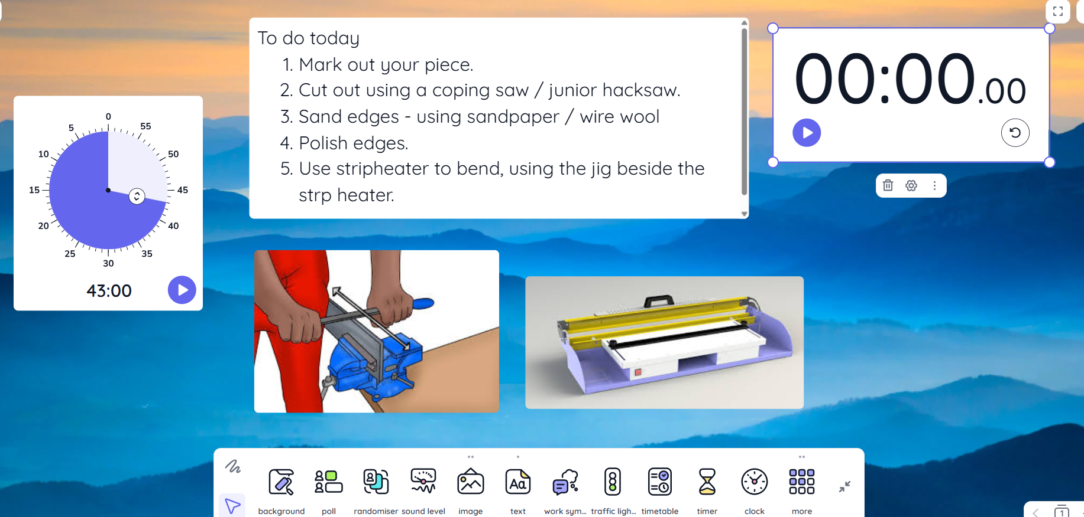

Slide 4
Strengths and Barriers
Barriers:
Lack of resources in classrooms- temporary building.
Inadequate use of resources when given to students.
Language a barrier in classes- EAL students, ASD students.
Strengths:
Teacher engagement – use of subtitles, classroom screen, student feedback.
Device school, leadership support, staff on board (large new staff).
Free book scheme- able to get resources- redirected

Slide 5
IMPACT ON THE SCHOOL COMMUNITY
Students – no excuses for not engaging, books, copy, pen etc..
Teachers – removing barriers.

Slide 6
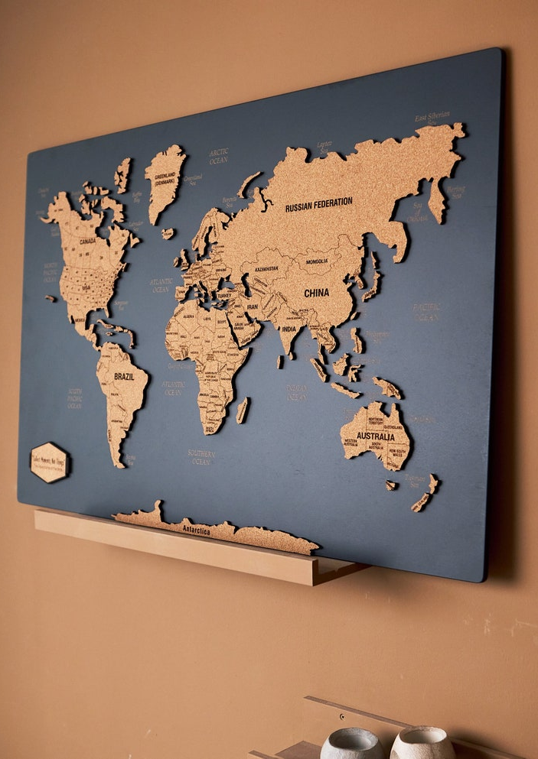
Next Steps
Language Barrier
Look at student cultural – Culture day, means of representation, belonging to, map in the school.
Prayer room / area.
Calendar of Cultural Events.
Next on the survey was low self confidence and anxiety.
CBAs and Anxiety – samples of presentation – video , verbal, online, PowerPoint, hand drawn, model making. – UDL Team to make.

