Slide 1

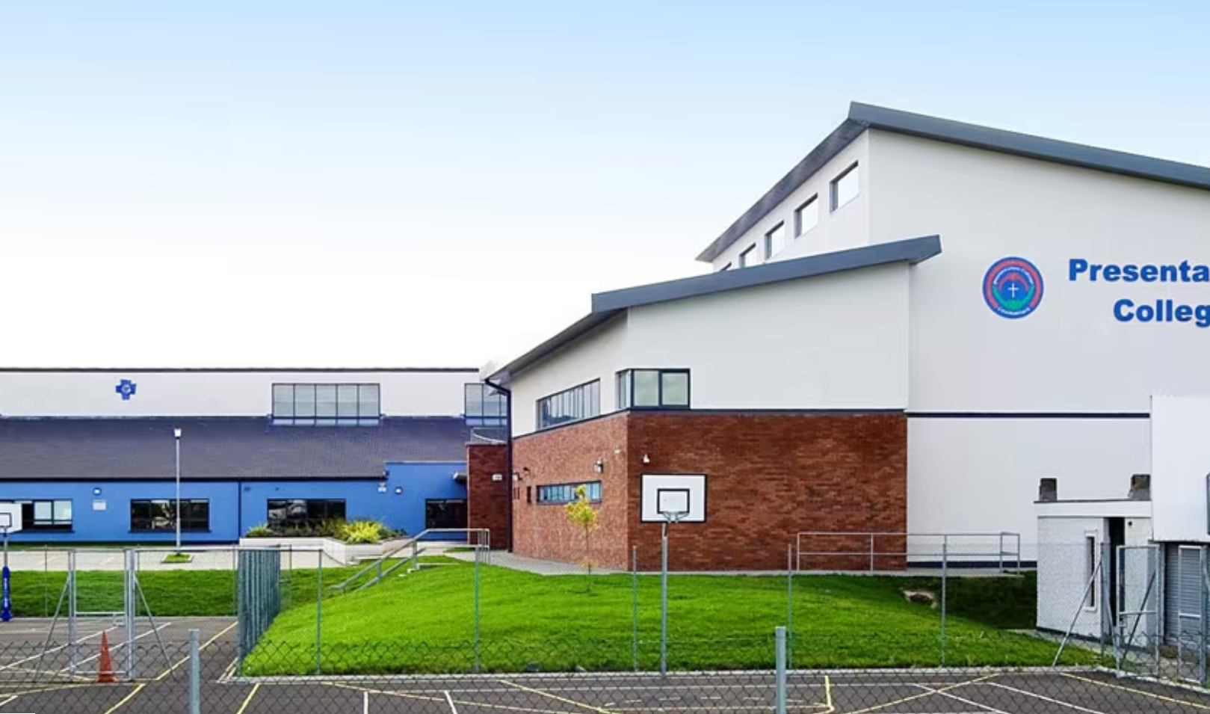
Presentation College Carlow
Our UDL Connected Journey

Slide 2
Our Journey
Our project has focused on celebrating current UDL practice within our school community.
Staff meeting time has been set aside throughout the year for staff workshops and sharing of best practice
We felt this laid firm foundations for moving forward and would make the project more sustainable.

Slide 3
What worked well?
In house presentations
The Audit
The Padlet
Staff leading by sharing their own practice
Linking this to LAOS and to our school ethos and the wider CEIST charter
Naming the project and participants
The Action Plan

Slide 4
Challenges
Time
Getting everyone on board
Staff being willing to put themselves out there

Slide 5
The Impact
Small changes to start and choice for staff
Conversations about UDL are happening!
Students are more engaged
Positive parental feedback
UDL is part of the conversation for the longer term.

Slide 6
Next Steps
Giving UDL a more ‘concrete’ and permanent place within our school.
Reviewing and showcasing at school level rather than just department level
Recruit new core team members!
Linking to SSE and the wider SC reform

Slide 7
Reflection…
Changes to my personal practice- choice is much more of a feature
Energy!
Appreciated our personal context (students, staff etc.)
Recognised the importance of not rushing

