Slide 1

Marshalstown National School
Marie Claire Morrissey
Catherine O’ Neill
UDL ConnectED
Notes:
NOTE:
To change the image on this slide, select the picture and delete it. Then click the Pictures icon in the placeholder to insert your own image.

Slide 2
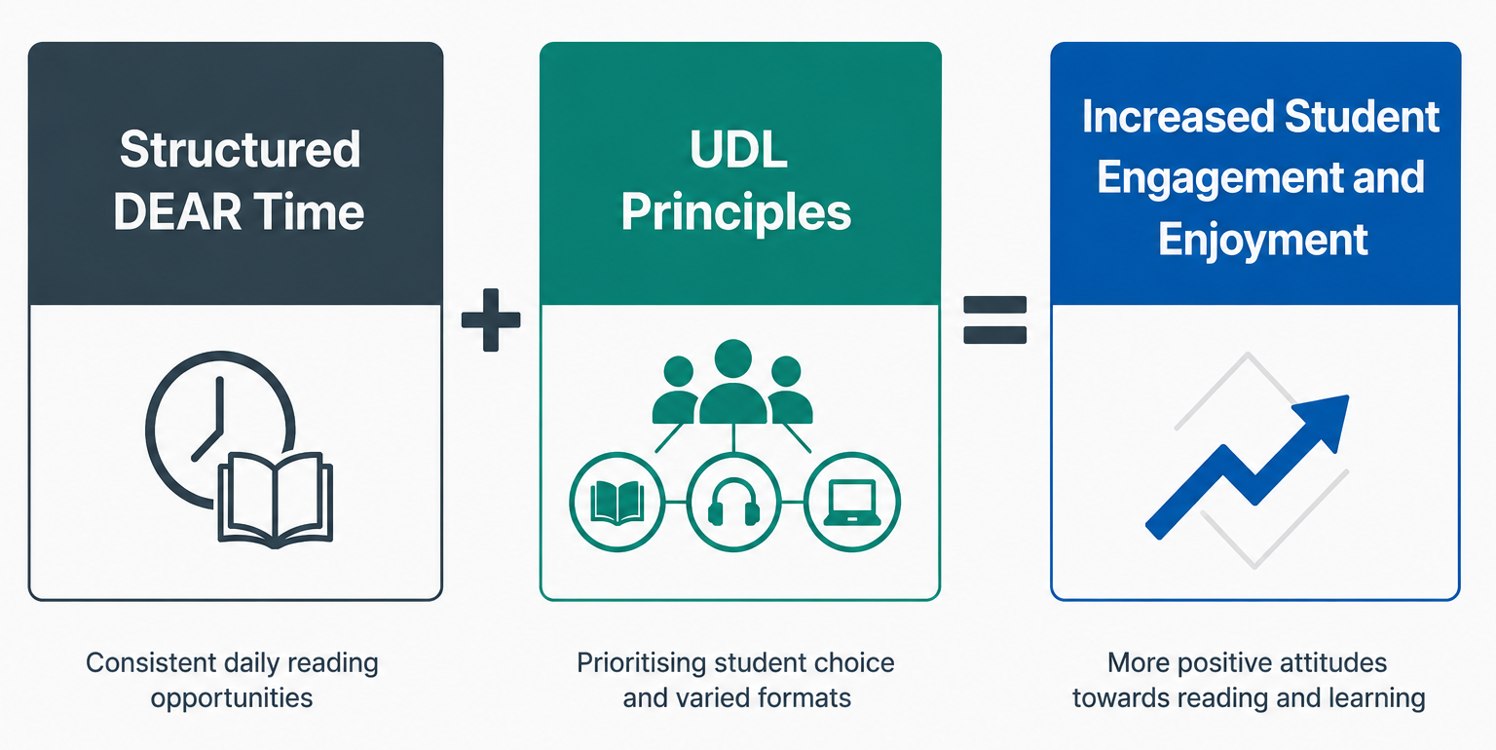

Designing the Intervention: What we did and why

Slide 3
Evaluating the Process: Barriers and Strengths
Strengths
Leadership support
ICT
Collaboration
Timetabling
Resources
Barriers

Slide 4
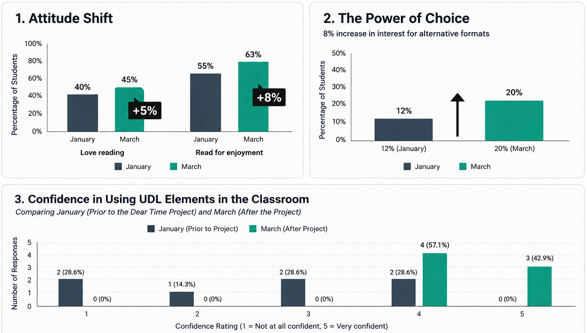
Impact on the School Community

Slide 5
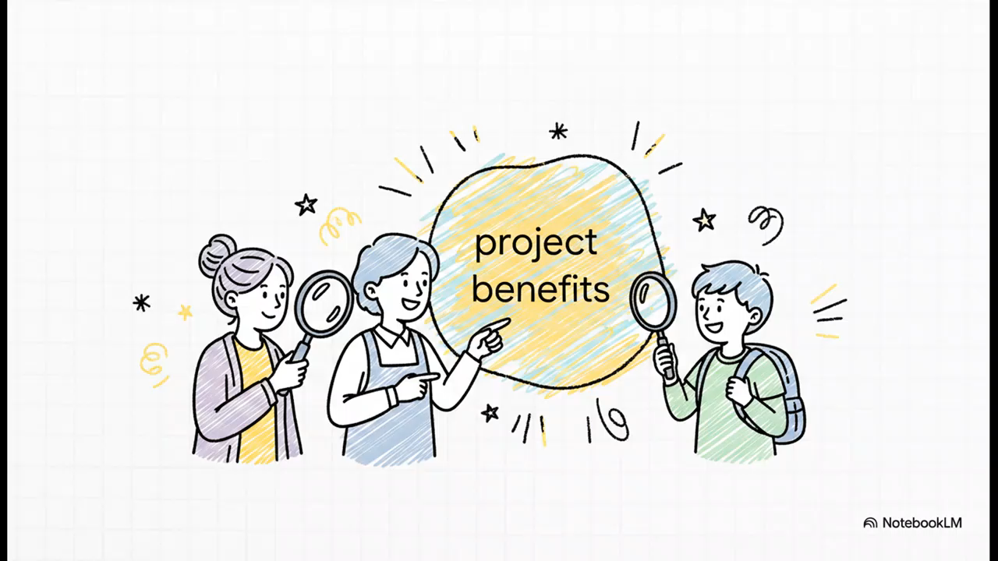
Teacher, S.N.A. and Student Feedback

Slide 6
