Slide 1


Slide 2
Overview
Project Outline
Strengths
Barriers
Impact on School Community
Next Steps
Professional Impact

Slide 3
UDL
Knowledge of UDL
Existing Practices
Existing Practices
Ideas in classes
UDL Noticeboard
Examples from classes

Slide 4
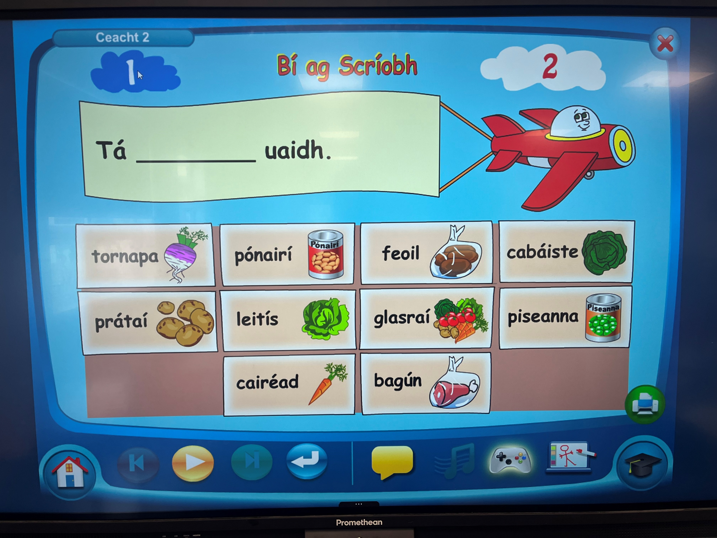

Slide 5
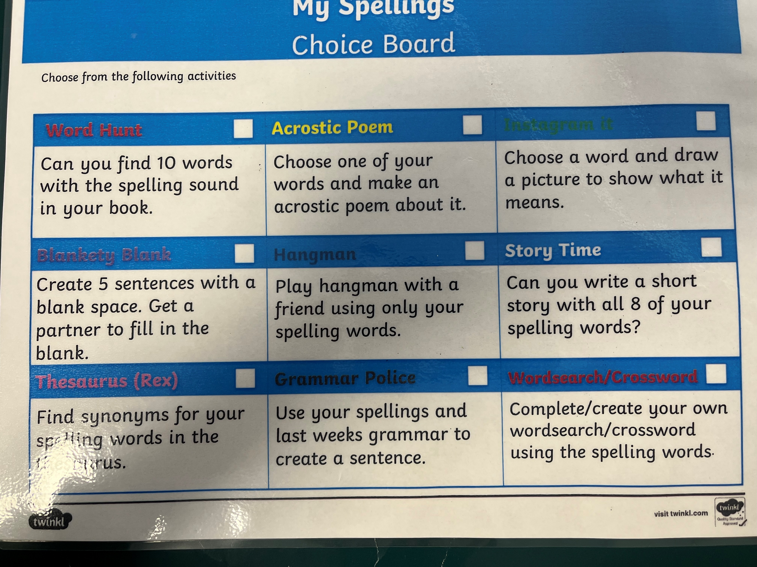

Slide 6
Strengths
Already Exists
Good Buy In
Good understanding
Primary
Curriculum
NCSE Relate
DÉIS

Slide 7
Barriers
Attitude
Understanding
Junior School
Community

Slide 8
Homework
Choice and Flexibility
Engagement
Same work
Student/parent autonomy
Higher levels of homework completed.

Slide 9
Lanyards
DEIS
Planning
School Practice
Community

Slide 10
